Slide 1
First, Do No Harm CBL for medical staff - CIT
Slide 1: Opening title screen
This is the title slide.
(Intro music plays)

Slide 2
First, Do No Harm CBL for medical staff - CIT
Slide 2: Intro video
Tom Zweng and Denise Mihal intro video. A presenter’s first appearance will have a name and title underneath. Tim will add the titles (rather than An Tran).
All presenter videos will auto-play. Instructions to hover-over the video to view video controls will appear under the first few videos.
Tom Z and Denise Mihal:
Tom Z: Hello and welcome, my name is Tom Zweng, the Chief Medical Officer for Novant Health, and I am here today with Denise Mihal, the Chief Nursing and Clinical Operations Officer for Novant Health.
We want to thank you for taking the time to watch this presentation, and more importantly for your commitment to help us transform our culture at Novant Health to one where patient safety always comes first. This is what First, Do No Harm is all about. We are seeking to make our healthcare system more reliable – a system in which the main component is people focused on supporting people. The healthcare team members in our system are working very hard to deliver remarkable experiences to our patients – and we want them to understand that remarkable experiences begin by creating and sustaining a culture of safety where we consciously seek to reduce errors and prevent events that can harm our patients and team members. (continued on next slide)

Slide 3
First, Do No Harm CBL for medical staff - CIT
Slide 2: Intro video (continued)
Denise (continued from previous slide): While you may not hear about these safety events in the course of your day-to-day practice, they can and do occur around our system. These events are, by definition, preventable, and for the most part do not occur because of a complex diagnosis or procedure. Instead, they occur due to simple things like poor handoffs, lack of attention to detail, failure to stop when uncertain or when someone on the care team voices a concern, or due to a power gradient that does not allow others to speak up and offer valuable information or insight. Today, we’re going to focus on that idea of teamwork and creating a collegial environment where there is no fear around crosschecking each other or voicing concerns to keep our patients safe. Over the course of this presentation, you will hear from different members of the Novant Health leadership team, representing various professional groups that make up the excellent team of healthcare providers we work with each and every day. (continued on next slide)

Slide 4
First, Do No Harm CBL for medical staff - CIT
Slide 2: Intro video (continued)
Tom Z (continued from previous slide): Many of you have participated in viewing these videos in the past. I am hoping that you have already noticed that we are using a different format than in the past. This time, aside from physician leaders discussing various aspects of safety, we are now joined by our nursing and pharmacy leadership partners. We all recognize that it takes a cohesive team to safely take our patients through all the different aspects of care. It is the team of nursing, pharmacy and providers that are essential in working hand-in-hand to make sure the patient is well cared for. So, we thought it would be most appropriate if we, the providers, were joined by nursing and pharmacy leadership in discussing these important concepts.
Next, you’ll answer a quiz question followed by some required CME disclosure information. Then, Tom Trahey, the VPMA for Rowan Medical Center, Thomasville Medical Center and Brunswick Medical Center will review our goals and objectives for this program. Denise and I both thank you for your attention and participation in these videos and for implementing the strategies into your daily practice so that we can all focus on caring for those who come under our care in a safe and reliable fashion.

Slide 5
First, Do No Harm CBL for medical staff - CIT
Slide 3: Question
Question
Here is the text that pops up if they get it wrong:
The answers from top to bottom are false, false, true. Not all of your matches were correct. Consider the following information about the healthcare statements:
Serious safety events are actually more commonly associated with basic functions such as poor communication at patient handoff, failure to stop when in doubt, or not voicing a concern when you are part of a healthcare team.
Actually, safety procedures from other high tech industries such as aviation and nuclear energy are effective in healthcare.
Safety is a simple, fundamental practice that we must do in every dimension, every time.

Slide 6
First, Do No Harm CBL for medical staff - CIT
Slide 4: Course details
CME statement. No video or sound.

Slide 7
First, Do No Harm CBL for medical staff - CIT
Slide 5: Disclosure information

Slide 8
First, Do No Harm CBL for medical staff - CIT
Slide 6: CME details

Slide 9
First, Do No Harm CBL for medical staff - CIT
Slide 7: Goals and objectives
Name and title will appear at first presenter appearance. The hover-over instruction appears below the video for the first few videos.
Tom T: Hello, I’m Tom Trahey, VPMA for Rowan Medical Center, Thomasville Medical Center and Brunswick Medical Center . Our goal today is to develop a deeper understanding of our fifth Safety Behavior, Support Each Other, by explaining how Collegial Interactive Teams can be used to catch, trap and mitigate errors that can lead to harm in healthcare. To help achieve this goal, we are first going to define Collegial Interactive Teams, or CITs, and then explain how they can be used to reduce harm in healthcare.
Second, we will describe the role of the team leader in establishing CITs. Next, we’ll seek to understand the need for CITs to create communication without barriers in our system. Finally, we’ll review the concept of Power Distance and how CITs establish an environment to overcome perceived Authority Gradients, which helps you get the information you need to make better decisions to keep our patients safe.

Slide 10
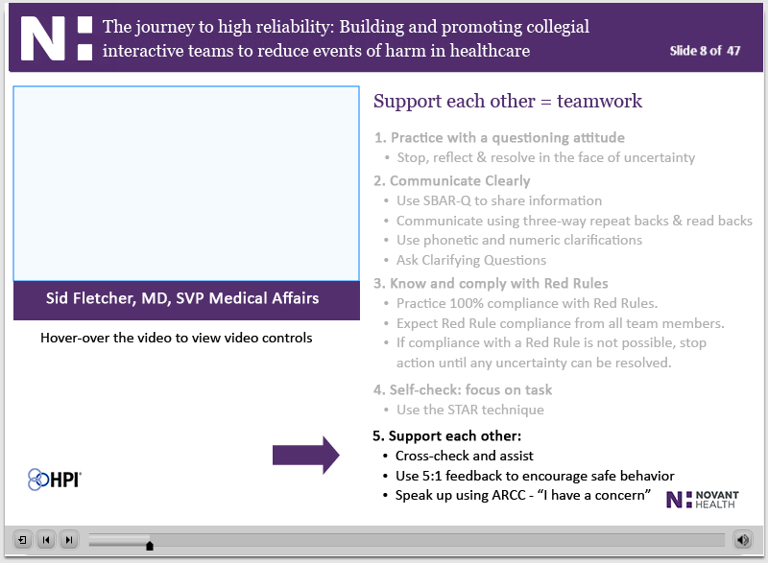
First, Do No Harm CBL for medical staff - CIT
Slide 8: Support each other
Each point fades in and turns from black to grey. Support each other stays black.
Sid: Hi, I’m Sid Fletcher, VPMA for the greater Charlotte market. Let’s talk about this concept of Supporting Each Other. We included this safety behavior in our error prevention toolkit back in April of 2009 because we recognized the power of teamwork. In order to create a vocabulary around good teamwork, we have a few tools you see listed at the bottom of the slide. First, Cross-check and Assist. This is all about peers checking the work of their colleagues, being willing to point out hazards or threats to safety. As we’ve talked about how to create an environment of good cross-checking, we’ve emphasized that the most important part is being willing to be checked.
The Assist part of the tool involves providing coaching and feedback. People learn by getting immediate feedback as closely as possible to the act. And, the best way to provide feedback is in a ratio of 5 positives for every 1 negative. Positive does not mean nice or pleasant – it means that your feedback encourages others to continue to perform that action in the future. Negative does not imply nasty or unkind – it simply makes the person on the receiving end less likely to perform that action in the future. Let’s look closer at this concept of 5 to 1 feedback.

Slide 11
First, Do No Harm CBL for medical staff - CIT
Slide 9: 5 to 1 – The magic ratio
This is a new slide from Steve.
Doug: Hi, I’m Doug Wall, VPMA for the Prince William Medical Center and Haymarket Medical Center. When we say that you should provide 5 to 1 Feedback, we are indicating that you should point it out much more often when colleagues are doing things right. Tell them “thank you”, “good job”, or give them a head nod or smile, which are all called “light touch” mechanisms to reinforce observed good behaviors. This creates a collegial environment which makes it OK to later provide corrective feedback when needed, without fear of retaliation or push-back.
This concept was researched as part of a ten year study by John Gottman, a well-known psychologist from the University of Washington. As part of the study, he videotaped 700 newlywed couples in one 15-minute conversation, and then went back and counted the number of positive and negative interactions. Based on the 5:1 model, he was able to predict who would still be married ten years later and was accurate 94% of the time. This and other studies have confirmed that people respond to the power of praise when it is focused and linked to specific behaviors. It also makes it easier to give the corrective feedback because it builds trust between individuals. As physicians you can provide positive feedback by telling the team things like “the OR setup looks good today” or “I appreciate you being receptive to my input” or even “thanks for getting the patient ready for an on time start”. As physicians we have all been trained to be hyper-critical of ourselves and of others, but when working with our team members, we need to take this concept of 5 to 1 to heart, because often times all they hear are the criticisms – even if that is not what we intend. As physicians, we are all informal leaders and play a very powerful role in culture change, so thank you for your help in using this technique to build a team that truly trusts and supports each other.

Slide 12
First, Do No Harm CBL for medical staff - CIT
Slide 10: ARCC it up to escalate concerns
Lars: Hello, I’m Lars Nycum, VPMA for the greater Winston-Salem market. The final tool to help define what it means to Support Each other is Speak up for Safety Using ARCC. ARCC is a measured way to respectfully elevate the level of one’s concern if they see something that they feel is safety critical. ARCC stands for Ask, Request, Concern and Chain of Command. The real focus of the tool is that word “CONCERN”. All complex, high-risk industries have safety code-words, so we want to treat it as such here at Novant Health. When someone tells you they are “Concerned”, take a moment to ask yourself why they have this genuine concern for your patient and what might have been missed that has led them to use that word.
Each of these tools that are part of our Support Each Other safety behavior are designed to help catch errors once they have occurred. As a physician you may not think you make errors or mistakes. Some of this stems from our training - many of us have been trained to be confident in our abilities to the point of believing we can’t make errors. But we’re all human, and humans make mistakes. After we answer a quick quiz question, we’re going to share with you a few examples of mistakes and errors that have been made within our walls here at Novant Health over the past couple of years with an emphasis on how better teamwork using our five safety behaviors could have easily avoided most of them.

Slide 13
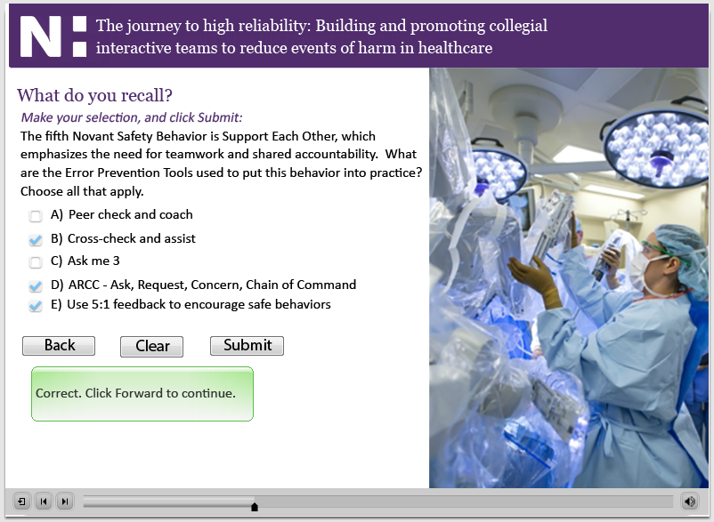
First, Do No Harm CBL for medical staff - CIT
Slide 11: Question

Slide 14
First, Do No Harm CBL for medical staff - CIT
Slide 12: Teamwork failures at Novant Health
Steve: Hello, I’m Steve Kreiser, patient safety consultant with Healthcare Performance Improvement. My background is from aviation where I was a Navy FA-18 pilot and officer for over 21 years, so I come from that culture of safety and reliability. Since retiring from the Navy eight years ago, I’ve been working with HPI to bring ideas from High Reliability Organizations into healthcare. HRO’s are those organizations that operate under very trying conditions all the time, yet manage to have fewer than their fair share of accidents.
During the course of my naval career, I made seven different deployments on five different aircraft carriers. On each of those ships there was a common theme with the healthcare industry in terms of what was needed to create a safe day – Leadership and Teamwork; leaders who set the tone that safety was integral to everything we did – and if we couldn’t do it safely, we weren’t going to do it. We also recognized that it took the entire team to afford safe outcomes. The youngest sailors on that ship were empowered to shut the flight deck down if they saw something that wasn’t safe. I can recall many a time holding overhead the ship while the crew did a quick walk-down of the deck to look for a lost tool or missing part to ensure it wouldn’t get sucked into my engine intakes upon landing. They did that because somebody felt empowered to speak up and admit something wasn’t right and stopped the line. There are a lot of lessons we can learn from that and other ideas from High Reliability Organizations, and we’re going to spend some time talking about them today with a particular focus on this idea of teamwork.

Slide 15
First, Do No Harm CBL for medical staff - CIT
Slide 13: Five principles
Question slide
Steve: Karl Weick and Kathleen Sutcliffe are researchers from the University of Michigan. They studied High Reliability Organizations and identified five principles of what HRO’s do to make their systems more reliable. Three of the concepts are grouped under Principles of Anticipation where leaders do everything they can to anticipate problems before they occur. Preoccupation with Failure is where leaders regard small, seemingly inconsequential errors as a symptom something bigger is wrong in the system. In order to find these problems, they take measured steps to get out to the front line to remain Sensitive to Operations. Reluctance to Simplify does not mean we make things harder than they need to be. Instead, it means we encourage diversity in experience, perspective and opinion.
The two Principles of Containment get to how we handle and bounce back from adversity. So a Commitment to Resilience means we’re not afraid to talk about our mistakes and learn how to prevent them in the future. Deference to Expertise means we take advantage of the unique skills and talents of our colleagues, regardless of rank or seniority in the organization. These five principles are the hallmark of any High Reliability Organization. I saw them in action during the many years I spent working in the complex and dangerous world of carrier operations, so I know they can help make us safer in the complex and high-risk healthcare environment as well.

Slide 16
First, Do No Harm CBL for medical staff - CIT
Slide 14: Mindfulness in action
Slide is animated.
Steve: Weick and Sutcliffe refer to these five concepts as mindfulness – doing whatever you can to be mindful of the system. I’d like to focus in on two of these principles in more detail and how they specifically relate to our fifth Novant Health Safety Behavior, Support Each Other. Reluctance to Simplify means we’re reluctant to simplify interpretations – that we discuss alternatives, seek out second opinions and are not afraid to ask questions or voice concerns. HRO’s know that you need to encourage the flow of information in order to make better decisions. Later in our discussion we’ll talk about a strong deterrent to being Reluctant to Simplify – something called Power Distance – which leads to perceived Authority Gradients, causing people to be hesitant or fearful to ask questions or voice safety concerns. (Continued on next slide)

Slide 17
First, Do No Harm CBL for medical staff - CIT
Slide 14: Mindfulness in action (cont)
Slide is animated.
Steve: (Continued from previous slide) The second principle we will focus on today is called Deference to Expertise, which is where we take advantage of the unique skills of our colleagues and when a crisis occurs, we rapidly pool our collective expertise to resolve it. When landing aboard an aircraft carrier, there are officers standing right beside the touchdown area, where the planes’ tailhooks are trying to catch one of four arresting gear wires. Those officers, called Landing Safety Officers, or LSO’s, were there to tell you if you were high or low or needed to come left or right to line up with the landing area. They also came by your squadron Ready Room after you got out of your flight gear to give you a grade for each and every landing. Here’s the key – those LSO’s weren’t the most senior people on the ship. They were young pilots who stood out there on the platform each day watching landing after landing. They developed a highly trained eye and could tell if you were above or below the glideslope even before your instruments in the cockpit indicated there was a problem. And they had the authority granted from the captain of the ship to wave planes off or divert them to a land-based runway if things were not going well. That’s Deference to Expertise – building a team where everybody plays a part and is valued for their contributions and as such is given the authority to make decisions relative to their areas of expertise.

Slide 18
First, Do No Harm CBL for medical staff - CIT
Slide 15: Collegial interactive teams
Herb: Hello. I’m Herb Clegg, SVP of physician services. These two principles we’ve just discussed, Reluctance to Simplify and Deference to Expertise, help form the basis for an introduction to the concept of Collegial Interactive Teams, or CITs. John Nance is an award-winning author, commercial and retired Air Force pilot, lawyer and recognized expert on Crew Resource Management. His book “Why Hospitals Should Fly” describes the benefits of Crew Resource Management, or teamwork, applied to the healthcare environment. Nance coined the term Collegial Interactive Teams to describe an environment where colleagues are completely comfortable sharing information and pointing out human error. He provides a number of specific points on how to put the concept into practice, shown here on this slide. (Continued on next slide)

Slide 19
First, Do No Harm CBL for medical staff - CIT
Slide 15: Collegial interactive teams (cont)
Herb: (Continued from previous slide) First, team leaders are required to lead with the full participation of their teams – while teams need to be assertive with respect.
Second, team leaders need to assign tasks to the appropriate people while they maintain the big picture.
Third, Collegial Interactive Teams can’t be effective without mutual caring, respect and support.
Fourth, Collegial Interactive Teams can’t be effective without barrierless communication, which can’t occur if the culture discourages people from speaking up.
And Fifth, there can’t be barrierless communication if the team leader’s control is based on hierarchy, arrogance, defensiveness or authoritativeness, what you can think of as a dictatorial style.
Our fifth Safety Behavior, Support Each Other through crosschecking and speaking up for safety, embodies many of these elements. In fact, Nance emphasizes that since humans are fallible, the only chance to keep human error from hurting patients is to crosscheck each other by creating Collegial Interactive Teams. Now, before we continue our discussion about cross-checking, let’s answer another quiz question.

Slide 20
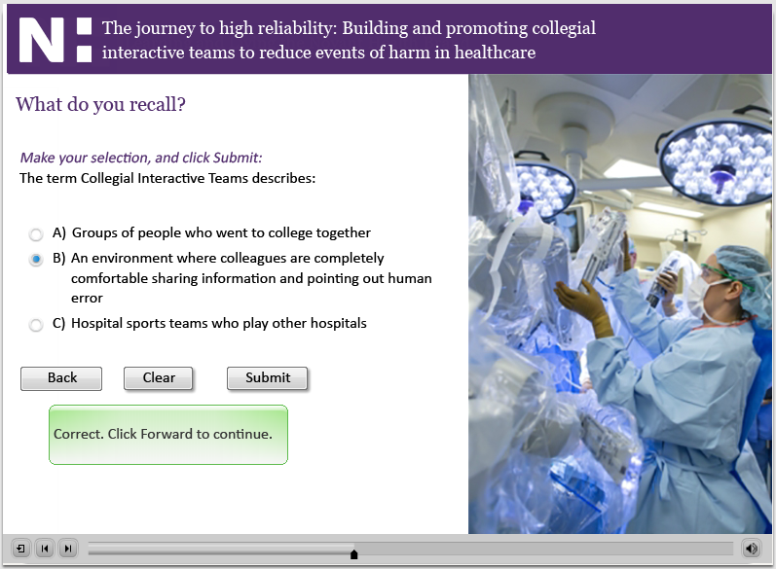
First, Do No Harm CBL for medical staff - CIT
Slide 16: Question

Slide 21
First, Do No Harm CBL for medical staff - CIT
Slide 17: Cross-checking in healthcare
Tom T: Nance recognizes what James Reason, the father of human error theory who came up with that Swiss Cheese Model we talked about in the other First Do No Harm credentialing module, and what other human performance psychologists have pointed out for years – that we are all error-prone. Humans are fallible, and even on our best day we still make errors on the rate of about 1 out of 1000 opportunities. But, if we believe in the power of good cross-checking, we can cross-multiply the error rates so when you make an error, I’m there to see it and speak up and offer a crosscheck to catch the error. And, here’s the important part – you’re willing to be checked, which establishes that collegial environment where it’s OK to point out human error.
Likewise, when I make a mistake, you’re there to provide me a cross-check and point it out and I’m similarly receptive. When we establish an environment of good cross-checking, the error rates drop to one out of a million – which really does create that high reliability organization we’re looking for.

Slide 22
First, Do No Harm CBL for medical staff - CIT
Slide 18: Cross-checking in healthcare
Steve: Here’s an important aspect of crosschecking: Sometimes we fail to cross-check a colleague thoroughly because we trust them. For example, a nurse fails to rigorously double-check a fellow nurse’s high-risk medication because he trusts that his fellow nurse knows what he’s doing. Or, a pharmacist fails to take a close look at the physician’s order because she trusts the stellar reputation of the care provider and assumes she knew what she wanted when she entered the order. Here’s my point – don’t misconstrue trust in someone’s ability with the need to provide thorough crosschecks. We’re all human and make mistakes from time to time – even the best and brightest among us. When we are working together, care enough about me to give me a thorough cross-check and point out an error to keep the patient – and me – out of trouble.
This is an important lesson from the cockpit, where the two pilots are always cross-checking one another. A common misperception is that they are both there so one can take over for the other if he becomes incapacitated. While that’s a nice ancillary benefit, the real reason is the power of crosschecking. They are constantly crosschecking fuel settings, routes of flight, engine instruments, etc. And when you look at how they approach this idea of Crew Resource Management, EVERYBODY is considered part of the team, including the flight attendants, the air traffic controllers and the aircraft maintainers – all working together to catch and trap those hidden sources of human error. Now, let’s hear about a great cross-check catch.

Slide 23
First, Do No Harm CBL for medical staff - CIT
Slide 19: Cross-check story
Sid: I’m here with Cindy Jarrett-Pulliam, VP of Nursing and Market Chief Nursing Officer, to talk about a great cross-check story from Novant Health where a thorough cross-check prevented harm.
Cindy: “Mr. Smith” was admitted for a recent fall with a right hip dislocation. A surgeon was consulting on several patients on this unit. While scheduling procedures, the surgeon placed a sign and hold order for the wrong patient (Mr. Smith) into Dimensions. The physician had inadvertently scheduled Mr. Smith to have a sigmoid colectomy.
The transportation tech arrived to the unit to take Mr. Smith to the OR for a sigmoid colectomy. The RN stopped the line by practicing with a questioning attitude; she contacted the OR and Hospitalist regarding Mr. Smith’s plan of care. The OR team cross-checked by validating with the surgeon so that the correct surgery orders were placed on the correct patient.
Sid: By using the safety behaviors of practicing with questioning attitude and supporting each other through cross-checking, an event of harm and surgical serious safety event was prevented. So, where does building effective collegial interactive teams start? It starts with good leadership.

Slide 24
First, Do No Harm CBL for medical staff - CIT
Slide 20: Effective team leadership
Herb: Building effective Collegial Interactive Teams and communication starts with leadership – leaders who lead with the full participation of the team and with team members who are respectfully assertive. Here you see the definition of leadership - The ability to direct and coordinate the activities of other team members while inspiring them to work together to achieve a common goal.
We’ve all probably worked for some good leaders over the course of our careers, and perhaps we’ve also worked for some leaders who were not so good. Good leaders who inspire us to common goals possess traits you see here. While they are all important, leaders who build Collegial Interactive Teams really focus on those elements shown in bold - they’re respected and respectful, they empower fellow team members, provide 5:1 feedback while keeping the team informed, they demonstrate humility, composure and grace under pressure. (Continued on next slide)

Slide 25
First, Do No Harm CBL for medical staff - CIT
Slide 20: Effective team leadership (cont)
Herb: (Continued from previous slide) Each of these traits helps to build and maintain a professional atmosphere, which creates that collegial environment that fosters information-sharing. As a physician, our team members, and in a larger sense our society looks up to you as a leader simply because of the letters behind your name.
Please take advantage of that important, influential role by building and supporting effective teams committed to providing safe, high quality care, whether you work in the OR, radiology, the lab, on a floor unit, in an office or outpatient practice or really any healthcare setting.
So, how do we encourage a professional atmosphere?

Slide 26
First, Do No Harm CBL for medical staff - CIT
Slide 21: Professional atmosphere
Rolling over the graphic enlarges it.
Doug: Building and maintaining a professional atmosphere starts with leaders who set the correct tone for information sharing, right from the beginning. A study by NASA in 1993 found that in terms of building an effective team, it all starts with a Brief that includes things like personal greetings, politeness, tone of voice, eye contact and body language.
Even the choice of words is important, with team goals indicated with the words “We and “Us” vs. “I” and “You”. In healthcare we can take this to the next level by always centering our conversations around what’s best for the patient. Invite questioning attitudes on the part of all members of the team by making it a clear expectation – literally telling team members that if any of them see anything unsafe, they are expected to speak up.
Let’s learn more about effective briefing.

Slide 27
First, Do No Harm CBL for medical staff - CIT
Slide 22: Briefs improve teamwork
Lars: There have been a number of studies over the past few years indicating the many benefits of briefs. The first one I’d like to share with you is shown here from some research conducted in 2008 at the William Beaumont Hospital in Royal Oak, Michigan.
In their study of over 37,000 briefs, researchers found that 90% of the participants felt the briefs were effective in improving communication and teamwork. The average briefing time ran just under three minutes, which brings us to the second study.

Slide 28
First, Do No Harm CBL for medical staff - CIT
Slide 23: Briefs save time
Tom T: In the November 2008 Archives of Surgery, a study involving 422 respondents found that preoperative briefs reduced unexpected delays in the surgical setting by an average of 31%. While this seems counter-intuitive when thinking about the additional time needed to conduct a brief before every procedure, researchers found fewer delays due to missing equipment, medications or people. This study also recognized the improvements in communication with fewer breakdowns relating to information transfer.

Slide 29
First, Do No Harm CBL for medical staff - CIT
Slide 24: Briefs save lives
Herb: In perhaps the most compelling study that supports the use of briefs and other Crew Resource Management concepts from the aviation industry, an October 2010 study conducted by researchers from a number of different institutions, including the Dartmouth and Baylor medical schools and published in the Journal of the American Medical Association, found a positive correlation between the implementation of a medical team training program and surgical mortality.
The study looked at 108 Veterans Administration hospitals and found that in those facilities that had received training in team concepts, including briefings and debriefings, there was an average 18% reduction in annual mortality versus a 7% reduction in facilities who had not implemented the program.

Slide 30
First, Do No Harm CBL for medical staff - CIT
Slide 25: When to brief and debrief
Lars: Of course, we’re all required by the Joint Commission to perform and participate in the timeout before any kind of invasive procedure or treatment. This is a recognized best practice to reduce wrong patient, wrong procedure or wrong site events. But the timeout really is just the minimum briefing information required when conducting a complex, high-risk procedure. In certain situations in the OR, OB unit or ICU, there can be times when a more expanded brief is needed to ensure all members of the team have the information they need to provide the safest care possible to our patients. (Continued on next slide)

Slide 31
First, Do No Harm CBL for medical staff - CIT
Slide 25: When to brief and debrief (cont)
Lars: (Continued from previous slide) So, in these situations, think about how to implement some of these concepts around briefing, including the use of the procedural safety checklist like the one adopted by Novant Health that you see here in the rollover image, to integrate all members of the team while creating a collegial environment needed for good information sharing. The following situations are good examples of when using a checklist to conduct a brief can be helpful: the procedure is infrequently done; when a new person will participate on the team; when there are several ways to perform a procedure; when unique or specific equipment is required and essential for successful outcomes; and when a procedure is complex or the situation is critical.
And, just like the Captain of a commercial airliner, look for opportunities to lead the brief or the timeout. The care team looks to you as a leader, and leaders set the tone for information sharing by leading the brief to set that professional atmosphere we’re looking for and covering all contingencies needed to keep our patients safe.

Slide 32
First, Do No Harm CBL for medical staff - CIT
Slide 26: Briefing story
Tom T: I’m here with Michael Vaccaro, VP of Nursing and Market Chief Nursing Officer, to talk about a story from one of our facilities that demonstrates the power in briefing. An elderly, demented patient was admitted over a weekend for a fall resulting in a fractured left hip; requiring surgical repair.
Michael: During the initial patient check in and prior to the final timeout the scrub nurse had a concern regarding the surgical marked site of the right leg, noting it was longer than the left leg. In her experience, the fracture side is typically shorter. A procedural safety checklist pre-briefing and timeout was performed. The consent was for the left leg. However, the right femur had been marked for laterality. During the timeout, the x-ray was reviewed. However, it had accidentally been placed on the illuminator backwards, giving the appearance that the fracture was on the patient’s right side. The scrub nurse spoke up to the surgeon regarding her concerns that the wrong leg had been marked for surgery. The team was in fact getting ready to operate on the wrong hip which was averted by the nurse speaking up. (continued on next slide)

Slide 33
First, Do No Harm CBL for medical staff - CIT
Slide 26: Briefing story (cont)
Tom T: (continued from previous slide) By having a thorough time-out in the form of a briefing, situational awareness was built among the team allowing this nurse to freely speak up when something wasn’t in accordance with the brief. When we don’t have thorough, engaging briefs, or when we do briefing poorly, here’s what can happen. A patient with significant cardiac history presented to the emergency room with chest pain and positive troponin. A non-emergent heart catheterization was scheduled 2 days after the admission. Pre-procedure planning included the indication for a Bare-Metal stent to be placed during the heart catheterization due to the patient’s other underlying medical issues. On the day of the scheduled procedure, a distraction occurred in the procedure room around the time the stent was being placed onto the sterile field. Verification of the correct stent type did not occur by the team; therefore a drug eluting stent was placed instead of the indicated Bare-Metal stent, altering the indicated treatment plan for this patient.
Ensuring that we use our Self Check: Focus on Task safety behavior and our cross-checking error prevention tool along with effectively utilizing checklists can contribute to the reduction in events of harm to our patients. Let’s answer another quiz question, then we’ll talk about overcoming barriers to effective communication.

Slide 34
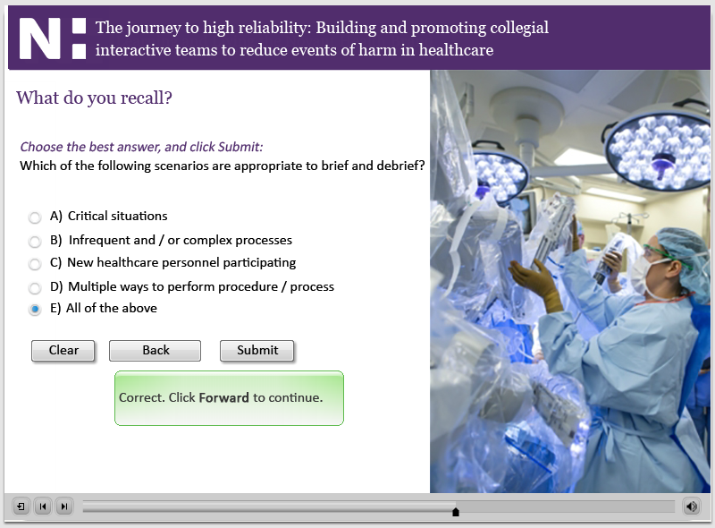
First, Do No Harm CBL for medical staff - CIT
Slide 27: Question

Slide 35
First, Do No Harm CBL for medical staff - CIT
Slide 28: Barriers to effective communication
Steve: The Joint Commission says that 70% of all patient harm events are due to communication errors. During my naval career we took special steps to ensure clear point to point communications because flying is a high-risk business and you have to make sure you transfer information clearly, completely and accurately. So we were rigorous and prudent in how we communicated, because there are so many barriers to clear communications, some of which you see here on this slide; things like preconceptions or assumptions, authority gradients, information overload or underload, distractions and jargon, social, cultural barriers and interpersonal conflict. Each of these barriers are problems that lead to communication being blocked – it’s either not sent clearly by the sender or it’s not received accurately and understood by the receiver. And that’s a big problem, because communication is not what I say, it’s what you hear.

Slide 36
First, Do No Harm CBL for medical staff - CIT
Slide 29: SBAR-Q
Steve: SBAR-Q is a great tool to help reduce communication and handoff failures and is known as content formatting. There’s a story circulating in surgery journals that it was invented by the United States nuclear Navy, while some folks think it was invented by Kaiser Permanente. My last position in the Navy was as the Air Operations Officer for Admiral Dan Holloway, Commander of the USS ENTERPRISE Battlegroup. When we were on station in the Persian Gulf and a Revolutionary Guard patrol boat was approaching our formation in the middle of the night from the coast of Iran, he expected us to use this type of format when we had to call him from his command center where we were manning the watch through the night. You’d wake him up, tell him the Situation, give him some Background, our Assessment as watchstanders – perhaps we thought the patrol boats where displaying hostile intent – and then give him a Recommendation – for instance, that we thought we should turn the battlegroup south and increase our speed to reduce the threat. Very effective, but it would take some training and practice to get good at thinking and speaking this way, so it takes some work on both the transmitting and the receiving end to become good practitioners of SBAR. (Continued on next slide)

Slide 37
First, Do No Harm CBL for medical staff - CIT
Slide 29: SBAR-Q (cont)
Doug: (Continued from previous slide) In healthcare, SBAR is used by physicians to solve a physician-to-nurse communications problem. You see, nurses are trained to be a patient historian – they want to tell stories chronologically. Physicians are trained to be problem solvers – they want to be given a problem, so they can then give a solution, or diagnosis. So, they have a difference in communication style that can result in conflict – the nurse wants to put the problem at the end, but the physician wants it first. So the compromise is SBAR. Give me the headline – in other words, the Situation – to get my attention. Then, I will listen to the background information. If you have some insight, share it with me as your assessment, and then tell me what you want. You can couch it as a recommendation or better yet as a request – that you’re asking for something. So here would be a typical SBAR-Q conversation:
Sorry to bother you at home doctor, this is Doug on the med-surg unit. I’m calling to talk to you about your patient Jan Green who’s in a lot of pain. Here’s some background - Mrs. Green came to us two days ago for a total knee replacement, and before the procedure she was on a lot of high strength narcotics to manage her chronic pain. Here’s our assessment – we think she’s narcotic tolerant and these dose rates are just too low. I’m requesting an order to increase the dose. (Continued on next slide)

Slide 38
First, Do No Harm CBL for medical staff - CIT
Slide 29: SBAR-Q (cont)
Herb: I’m here with Cedric Terrell, SVP of Pharmacy, to talk about SBAR-Q. Quick and to the point, SBAR is such a good communication tool at Novant Health, we should use it for communications between all care providers and not just between nurses and physicians. And, we’ve improved upon it by adding on that “Q” for questions. This helps guide our thinking to ask ourselves if we have any questions or ask the physician or care provider if they have any questions.
Cedric: Making people feel comfortable asking questions or voicing concerns is very important in a high reliability organization – because anybody can ask a question when they know they’re right or knowledgeable about the topic. But, when you’re not quite sure or don’t want to highlight yourself, that’s when it’s difficult to raise that hand.
SBAR-Q is how team members are being taught to communicate patient status to you, which makes your job easier in the long run. Support them as they work to make this practice habit, because it will get you the information you need more clearly and concisely. Listen for this format in its entirety and constructively coach the staff as they strive to perfect the technique. Point them to their managers if you think more education or training is needed or it is not being used. Additionally, think about how you can use this tool in your own practice to communicate with other consulting physicians. (Continued on next slide)

Slide 39
First, Do No Harm CBL for medical staff - CIT
Slide 29: SBAR-Q (cont)
Herb: (Continued from previous slide) On the next slide, you’ll see video clips demonstrating why good communication is so important and how effective the SBAR-Q tool can be.
In the first clip you will note a poor handoff of information, one that leaves the provider frustrated and disinterested. In the second, you will see a marked improvement with the use of the SBAR format – clear and concise, which is exactly what you need to make good decisions. Note also in the second video that the pharmacist clearly verbalizes the words - Situation, Background, Assessment, and Recommendation - so that the listener knows the nature of the information being transferred.

Slide 40
First, Do No Harm CBL for medical staff - CIT
Slide 30: SBAR examples

Slide 41
First, Do No Harm CBL for medical staff - CIT
Slide 31: Communication openness
Lars: Recall that in our discussion around Collegial Interactive Teams, we need to have open communication. Unfortunately, there is a lot of evidence that we have not yet reached the level of communication openness needed in healthcare to achieve high reliability.
In 2010 the Agency for Healthcare Research and Quality released the results of their hospital survey on patient safety culture. Here you can see the sobering results. That first bullet tells us that a quarter of the staff you work with will NOT freely speak up if they see something that may negatively affect patient care. The second bullet shows that OVER HALF of the nurses, technologists and support staff DO NOT feel empowered to question the decisions or actions of those seen in authority. And, that final bullet indicates that over a third – 37% to be exact – are afraid to ask questions or voice concerns when they see something that isn’t right. This is a problem in healthcare – and the question is, what’s causing it?

Slide 42
First, Do No Harm CBL for medical staff - CIT
Slide 32: Power distance
Tom T: Much of the hesitation to speak up in healthcare comes from the high power distance environment that exists in many organizational cultures. You’ll remember from the other First Do No Harm credentialing module that Power Distance is the extent to which the less powerful expect and accept that power is distributed unequally. It can lead to strong authority gradients which is the perception of authority from the subordinate’s perspective.
Why do people sometimes perceive an authority gradient? Often it comes from the signs and symbols associated with rank, education or position in an organization. And while I would never propose we take away physician parking spots or lounges, we need to be sensitive to how these outward signs of prestige influence people’s perception of power distance and work to flatten hierarchies when it comes to speaking up, asking questions and voicing safety concerns. (Continued on next slide)

Slide 43
First, Do No Harm CBL for medical staff - CIT
Slide 32: Power distance
Tom T: (Continued from previous slide) In the 1960’s and 1970’s, Dutch psychologist Geert Hofsteed conducted extensive research on this topic as part of his “Hofsteed’s Dimensions”. One of these dimensions, which describes how humans interact with one another, is a particularly interesting measure known as the Power Distance Index, or PDI. This index measures Power Distance among cultures, and indicates attitudes toward hierarchy – in particular, how a culture values and respects authority. The higher the Power Distance in a culture, the less likely those in subordinate roles will question the actions or directions of individuals in authority.
From a culture standpoint, countries like Singapore, Indonesia, The Philippines, and certain Latin American countries have very high Power Distances, where certain gender, social or subordinate professional groups do not question the actions of those in positions of authority. They ranked at the top of the scale, and the United States was toward the bottom, indicating a moderate to low Power Distance culture.
What’s interesting is that despite the relatively flat power distance rating in the general American culture, it is viewed as quite high among certain professional groups, including nurses to physicians, other clinical staff to nurses, or even general staff to leadership. When these problems get rooted in a culture, they are very hard to overcome.

Slide 44
First, Do No Harm CBL for medical staff - CIT
Slide 33: Lack of teamwork in healthcare
Herb: You can imagine the impact power distance can have on teamwork in healthcare. A study cited in Dr. Bob Wachter’s book Internal Bleeding presents some alarming statistics on perceptions of teamwork in healthcare. 75% of surgeons thought teamwork was pretty good – rating it high on the scale. But other members of the team had a different point of view, with 39% of anesthesiologists, 28% of nurses and 10% of residents indicating teamwork was not at that level.
Cindy: This disparity can be explained by our understanding of Power Distance. Often times, those at the top of the Power Distance index are not even aware of the impact of their words and actions. But then again, sometimes they are and simply may not care. At one of our hospitals, a physician told a new nurse on her first day of work that “until she had been there for six months, he did not even want to know her name.” How does that kind of behavior affect that nurse’s ability to speak up and be a productive, engaged member of the team?

Slide 45
First, Do No Harm CBL for medical staff - CIT
Slide 34: Lack of teamwork in healthcare
Steve: The study from Dr. Wachter’s book detailed that 50% of surgeons thought junior team members shouldn’t question the decisions of senior physicians. Some of you may agree with this finding. But the aviation industry has recognized the dangers of this fear factor and taken measured steps over the past few decades to overcome it. In fact, back in the 1960s when they were still flying DC-3’s, like the one shown here, there was a policy in effect at a major U.S. airline that specifically warned copilots that even if they knew the captain had made an error or mistake, they were not to point it out.
So would you want to fly on an airplane where you knew the copilot was afraid to point out a captain’s mistake? Probably not - and I venture to say, if you were on the table undergoing surgery, you would want every member of that care team feeling comfortable to voice their safety concerns as well.

Slide 46
First, Do No Harm CBL for medical staff - CIT
Slide 35: Survey of 2,095 nurses and pharmacists
Lars: Now that we have a better understanding of the concept of Power Distance, let’s talk about its impact on individual and team behavior. In 2003, the Institute for Safe Medication Practices released the results of a study it conducted on workplace intimidation in healthcare. In a survey of over 2000 healthcare providers, including over 1500 nurses and 350 pharmacists, 88% of respondents had experienced condescending language or tone, 87% impatience with questions, 79% reluctance or refusal to answer questions or phone calls, 48% strong verbal abuse and 43% threatening body language.
Cedric: Obviously, this does nothing to support the formation of Collegial Interactive Teams. But what affect does it actually have on individual and team decision-making? The same study revealed that for those people who had experienced those various forms of intimidating behavior, 49% altered their handling of order clarifications or questions, 75% used avoidance techniques to clarify orders, 49% felt pressure to accept, dispense or administer a medication despite concerns, and in the most shocking bit of feedback, 31% - almost a third – allowed a physician to order medication despite concerns. Now, let’s learn more about managing our strengths toward the goal of reducing power distance and building and promoting effective collegial interactive teams.

Slide 47
First, Do No Harm CBL for medical staff - CIT
Slide 36: Managing strengths – diverging paths
Sid: In her book “Overcoming Your Strengths”, bestselling author Lois Frankel details how one’s personal strengths can become either assets or liabilities, depending on how they are managed and complimented by other skills. As the paths diverge, strengths that become assets will lead to reliable behaviors while those that become liabilities will become unreliable behaviors.

Slide 48
First, Do No Harm CBL for medical staff - CIT
Slide 37: The disruptive path
Sid: Let me demonstrate my point using an example. Here we see six attributes that are common to most physicians just by the nature of what it takes to get through their many years of education and training – intelligence, independence, objectivity, analytic capability, sense of urgency, and being an influencer. But, if not properly managed, these attributes can become liabilities – intelligence leads to elitism, independence leads to being team averse, objectivity can turn into becoming impersonal, analytic capability turns to being critical of others, a sense of urgency leads to impatience, and being an influencer looks like being non-supportive.
So, these incredible strengths become disruptive in the healthcare environment because they turn into unreliable behaviors that can then lead to human error and system breakdown, and you can see things coming out like condescension, abrasiveness, belligerence, blame and shame, insensitivity or even sabotage. We have addressed behavior like this in our professional conduct policy, created and approved by our collective Medical Executive Committees. So please take the time to review that document thoroughly if you have not yet had the time to read it in its entirety.

Slide 49
First, Do No Harm CBL for medical staff - CIT
Slide 38: The success path
Lars: Here’s the good news. These same strengths can be turned into assets that lead to success and reliability. Intelligence becomes competence, independence becomes confidence, objectivity becomes critical thinking, analytic capability becomes good problem solving, sense of urgency leads to putting safety first, and being an influencer turns to becoming a team builder. Each of these assets contributes to building the High Reliability Organization we’re looking for, - Preoccupation with Failure, Sensitivity to Operations, Reluctance to Simplify, Commitment to Resilience, and Deference to Expertise.
Our professional conduct policy provides further guidance on the attributes we are looking for in the members of our medical staff around treating patients, visitors and other team members with courtesy, dignity and respect. Please consult this policy for more details. A link to the policy is provided at the end of this training.

Slide 50
First, Do No Harm CBL for medical staff - CIT
Slide 39: Caution! Providers and power gradient
Sid: Be on the lookout and listen for staff and residents who are attempting to address perceived power distance, because you might not even recognize it due to your position towards the top of the gradient. Our Novant Health Safety Behaviors provide us with a toolkit of safety codewords that can help indicate when a colleague or staff member is trying to tell us something important about the safety of our patients.
Encourage the use of terms like “Let me ask a Clarifying Question; I have a CONCERN; Let me check with my Chain of Command; and Let me repeat that back”. These are all part of our verbal vocabulary we’re trying to engrain in our culture to help empower staff to speak up for patient safety. Ask staff to use your first name when not in the presence of a patient to help overcome these barriers as well. It is not a sign of disrespect but rather a powerful way to flatten hierarchies. (Continued on next slide)

Slide 51
First, Do No Harm CBL for medical staff - CIT
Slide 39: Caution! Providers and power gradient (cont)
Sid: (Continued from previous slide) Use these terms and role-model them in your own practice. Ask team members to give you details about a patient’s condition in an SBAR, ask them to read or repeat-back important information, and listen for the various safety phrases you see on this slide.
Remember our High Reliability principle #3 – Reluctance to Simplify interpretations, which in a nutshell means we’re not afraid to ask questions and voice safety concerns. We really are just trying to improve information sharing, which does not take away from your authority as a physician or leader of a care team to make the decisions needed to provide high-quality care to your patients. What these codewords do is help to build that collegial environment that we know can help to catch errors while reducing events of harm.

Slide 52
First, Do No Harm CBL for medical staff - CIT
Slide 40: Power distance at Novant Health
Doug: You may think this concept of Power Distance is interesting but doesn’t really apply at Novant Health. Well, let me tell you a story of how it came to bear at one of our facilities and how a nurse’s commitment to escalating a concern resulted in avoiding harm to a patient.
Michael: A nurse noticed that her patient was deteriorating and contacted the inpatient care physician responsible. The physician was in the emergency department treating another patient and was resistive to responding quickly. Concerned, the nurse ARCC’d it up, using the chain of command to contact the rapid response team for immediate action. The rapid response team assessed the patient and moved the patient to the Intensive Care Unit. The patient was intubated 30 minutes later. Upon realizing the patient was moved to the ICU, the physician was upset because of the transfer without his input. After visiting the patient, the physician understood how ill the patient was and realized the move to the ICU was appropriate. The next morning, the physician made a point to visit with the nurse and apologize for being upset and vocal. (Continued on next slide)

Slide 53
First, Do No Harm CBL for medical staff - CIT
Slide 40: Power distance at Novant Health (cont)
Doug (continued from previous slide): The physician likely thought he was doing the best for his patient, yet he might not have realized how his behavior could affect the situation. By apologizing to the nurse and thanking her for being persistent, the physician solidified their shared commitment to patient safety and reduced the power distance. Had he said nothing, the physician would have increased the power distance.
Now, let’s answer another quiz question. Then, we’ll hear a great collegial interactive teamwork success story.

Slide 54
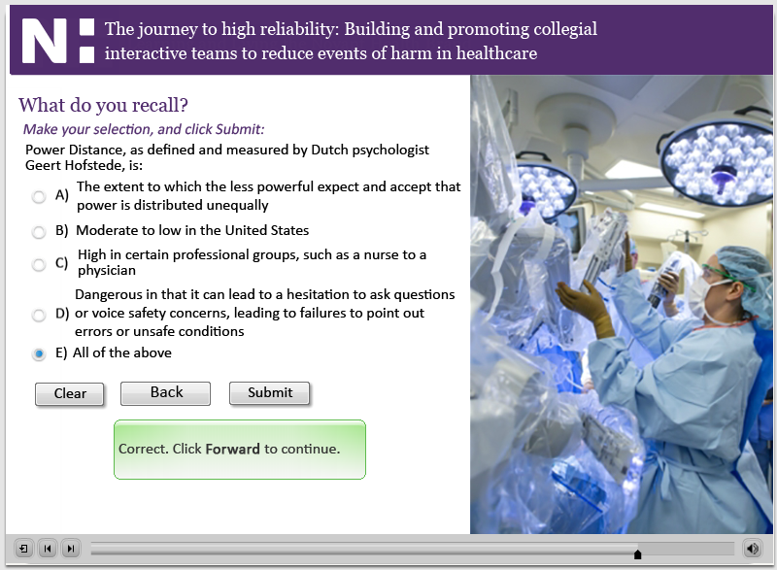
First, Do No Harm CBL for medical staff - CIT
Slide 41: Question

Slide 55
First, Do No Harm CBL for medical staff - CIT
Slide 42: Miracle on the Hudson
Steve: To demonstrate teamwork at its finest, I’d like to show you a short video clip on the next slide of an event I’m sure you will recognize. We all heard about the miraculous landing of US Airways flight 1549 on the Hudson and may have been transfixed by the rescue efforts of the ferry boat crews who pulled the stranded passengers to safety. But I want you to listen to the audio tapes from the cockpit voice recorders that have been added to this animated recreation of the event in real time. As you watch and listen, think about the different elements of good team work in action.

Slide 56
First, Do No Harm CBL for medical staff - CIT
Slide 43: Miracle on the Hudson

Slide 57
First, Do No Harm CBL for medical staff - CIT
Slide 44: The power of teamwork
Steve: The first thing that is evident from that clip is how quickly it all happened. The rapid-cycle decision making process was made possible because the crew had briefed those contingencies thousands of times in the past. The pilots were not only communicating with the air traffic controller, but with each other as well. Post flight interviews detailed how the copilot, Jeff Skiles, was actually the pilot flying when they hit the flock of birds. But there was a quick change of command with clear terminology – “I have the jet” followed by “Roger – you have the jet”. As Captain Sullenberger took over, the copilot started going through the emergency checklists to ensure they had covered all the procedures. (Continued on next slide)

Slide 58
First, Do No Harm CBL for medical staff - CIT
Slide 44: The power of teamwork (cont)
Steve: (Continued from previous slide) You probably heard the air traffic controller giving a lot of information to the crew in terms of flight directions and emergency runways. Sully probably didn’t have time for all that information and maybe didn’t need it – but at no time did he ever say “would you just shut up – if I want your advice I’ll ask you for it?” Of course not. That’s what being a team is all about – all members of a team working toward a common goal. The crew was recognized for their heroic efforts – and not just the pilots, but the flight attendants, the air traffic controller, even some other airline employees who were jump-seating to their next duty station. Wouldn’t it have been tragic to land that plane safely on the Hudson but have everybody drown in the back of the plane? It was the flight attendants who got them out. Similarly, you can be the best physician in the world but if your patient doesn’t have a room that has been cleaned by environmental services, with working equipment maintained by bio-med and facilities, with a nursing staff and other support department team members to take care for them while they heal, then it’s not the remarkable experience we are looking to deliver. In other words, it takes a team to provide remarkable care.

Slide 59
First, Do No Harm CBL for medical staff - CIT
Slide 45: Novant Health safety behaviors
Hovering over the numbers reveals the safety behaviors.
Tom Z and Denise Mihal:
Denise: We want to use all our Novant Health First Do No Harm Safety Behaviors and Error Prevention Tools to develop that same sense of Collegial Interactive Teams needed to prevent events of harm. These five safety behaviors are very effective in preventing human error, but first they have to be turned into practice habit – the first things we turn to in time of crisis. Think of these five behaviors like this – first, be vigilant in looking for those threats to the safety of our patients – in other words, have a good questioning attitude. Second, tell your colleagues about them – communicate them clearly. Third – stick with what we know is right. That’s what Red Rules are all about. Fourth, pay attention to detail when performing safety critical activities – take just a little more time when you feel like you’re operating on autopilot. In other words, check yourself. Then, check each other – that’s the essence of Supporting Each Other and cross-checking. (Continued on next slide)

Slide 60
First, Do No Harm CBL for medical staff - CIT
Slide 45: Novant Health safety behaviors (cont)
Tom: (Continued from previous slide) As well, in a supportive way, point out errors on the part of peers and coworkers, and never be afraid to speak up for safety, and allow others to do so as well. As members of the medical staff, you play a critical role in promoting Collegial Interactive Team engagement by encouraging team members to use these tools and techniques.
Make that personal commitment to talk about and use these tools and techniques each and every day in your practice. Others will follow your lead making us safer and reducing preventable harm to our patients.
Thank you again for your time and attention. We look forward to seeing you in person to discuss safety and reliability in more detail, and please feel free to reach out to any of us to discuss further. Thank you, and have a good day.

Slide 61
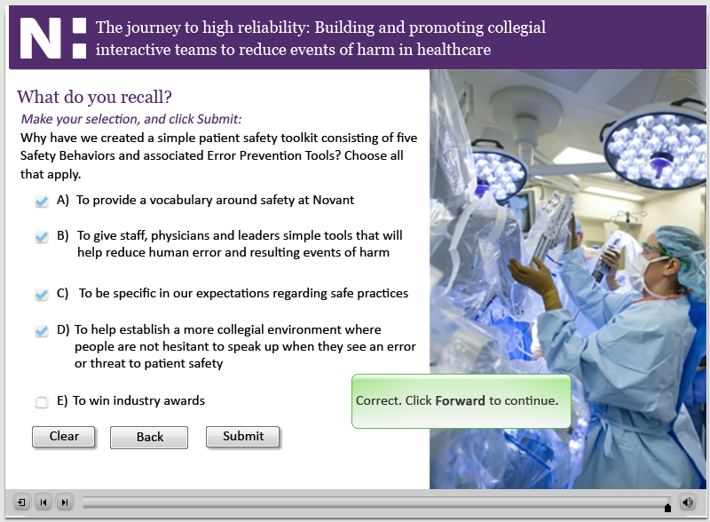
First, Do No Harm CBL for medical staff - CIT
Slide 46: Question

Slide 62
First, Do No Harm CBL for medical staff - CIT
Slide 47: Test instructions
Last slide. No narration or sound.

